Slide 1
A Study on Student Challenges and Their Impact on Academic Achievement
Research Project Presentation
Presented By:
Miss. Dnyaneshwari Namadev Khade
Miss. Shital Ramesh Davar
Mr. Vaibhav Shrikant Kore
Under the Guidance Of:
Mr. A. B. Bhosale
Assistant Professor / Research Guide
Department of Statistics
Vivekanand College, Kolhapur
Date: 29 April 2026

Slide 2

Abstract
Academic performance is influenced by a combination of academic, personal, and environmental factors. This study examines the key factors affecting student achievement and identifies the major challenges faced by undergraduate students.
The findings reveal that attendance, internal performance, study habits, motivation, stress, and family support play an important role in academic success. Common student challenges include lack of motivation, difficulty in understanding subjects, and poor time management.
Overall, the study highlights the need for a balanced approach that combines academic support, personal guidance, and institutional intervention to improve student performance and student well-being.

Slide 3
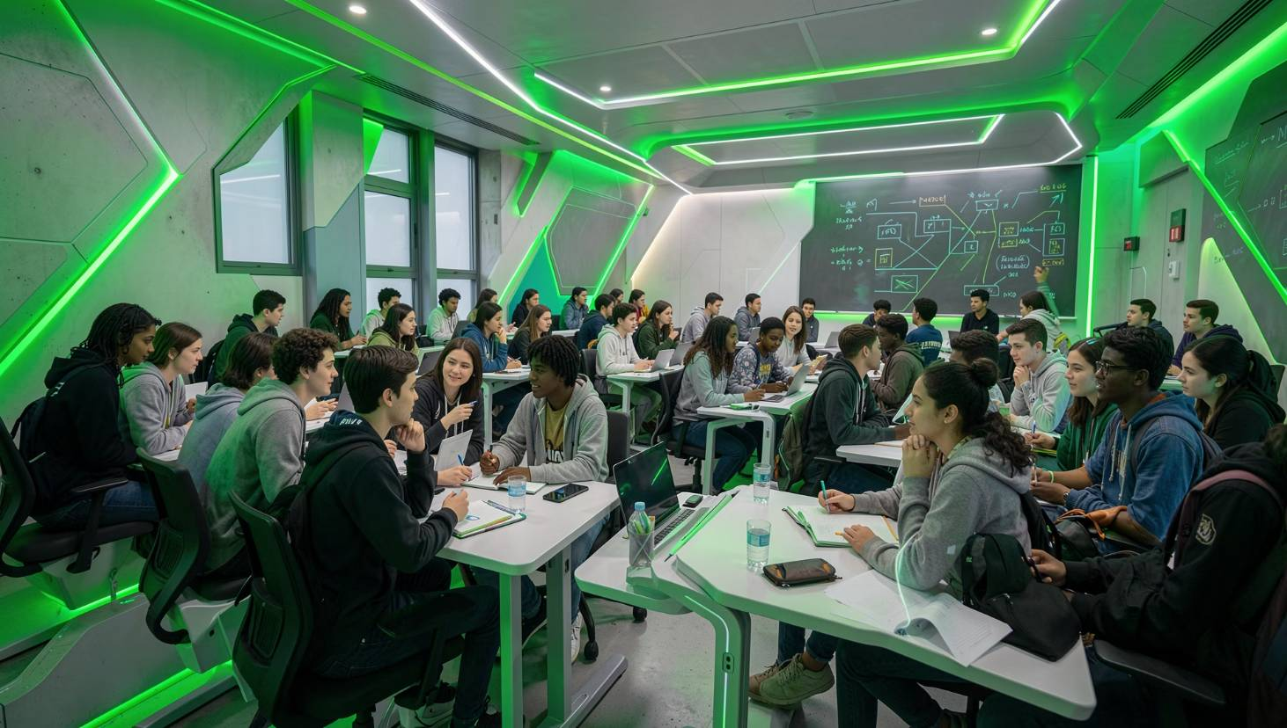
Introduction
Academic performance is one of the most important indicators of student success and the quality of education. It is influenced by various academic, personal, and environmental factors. Students often face challenges such as stress, lack of motivation, poor study habits, and difficulty in understanding subjects. These challenges can directly affect their academic achievement.
This study aims to analyse these factors, identify major student challenges, and use statistical and machine learning techniques to support better academic decision-making.
Review of Literature
Author
Key Contribution
Ramaswami & Bhaskaran (2009)
Highlighted the importance of feature selection for improving prediction accuracy.
Yadav et al. (2012)
Used academic data to classify students and identify weak performers early.
Vamanan & Ramesh (2013)
Studied the impact of personal, family, and academic factors on performance.
Adhatrao et al. (2013)
Developed a prediction system to identify students needing academic support.
Sujatha et al. (2018)
Predicted student performance for early academic intervention.
Li et al. (2019)
Applied clustering techniques to analyse student learning patterns.
Zhang et al. (2021)
Used academic records to identify at-risk students effectively.
Lynn & Emanuel (2021)
Reviewed various techniques for student performance prediction.
Ahmad et al. (2021)
Analysed machine learning applications in educational prediction.
Mustapha (2023)
Compared feature selection methods for performance prediction.
Hussain et al. (2024)
Predicted final exam results using data mining techniques.

Slide 4
Objectives of the Study
1
2
Objective 1
Objective 2
To identify and test the influence of various academic, personal, and environmental factors on students' academic performance.
To identify student difficulties in their studies using their information.
3
4
Objective 3
Objective 4
To examine and test the relationship between students' personal experiences, study habits, and their academic achievement.
To identify at-risk students, analyse student challenges, and study their support needs.

Slide 5

Data Collection and Research Methodology
Study Area
Kolhapur District
Research Design
Quantitative Cross-Sectional Survey
Target Population
Undergraduate students from Arts, Science, Commerce, and Management streams
Sampling Technique
Multistage Stratified Sampling
Proportional Allocation
Simple Random Sampling
Sample Selection Process
Urban and Rural stratification
Stream-wise classification
Random selection of colleges
Random selection of students
Sample Size Determination
Cochran's Formula
Finite Population Correction (FPC)
Data Source
Primary data collected through a structured questionnaire.

Slide 6
About the Data
Description of Dataset:
a) Source of Dataset
b) Name of the Dataset
c) Size of the Dataset
The dataset used for this study is based on primary data collected directly from students through a structured questionnaire designed for academic research purposes.
Student Academic Performance and Challenges Dataset (2025–26)
Number of observations (rows): 283
Number of variables (columns): approximately 35–40 variables
d) Data Source
e) Data Format
Primary data collected from undergraduate students in various colleges of Kolhapur District.
The dataset is maintained in Excel/CSV format. Each row represents an individual student respondent, and each column represents a variable obtained from the questionnaire.

Slide 7
Objective 1
To identify and test the influence of various academic, personal, and environmental factors on students' academic performance.
Descriptive Statistical Analysis of Key Variables:
Variable
study_hours
attendance
Stress
Sleep_Hours
count
283
283
283
283
mean
72.5833
2.5865
2.4310
2.4558
std
10.4549
0.8392
0.7229
0.8125
min
35
1
1
1
25%
65
2
2
2
50%
74.24
3
3
2
75%
79
3
3
3
max
95
4
3
4
Interpretations: Students have moderate academic performance with some variation, and factors like study hours, attendance, stress, and sleep are mostly at average levels. This shows performance is not same for all students.

Slide 8
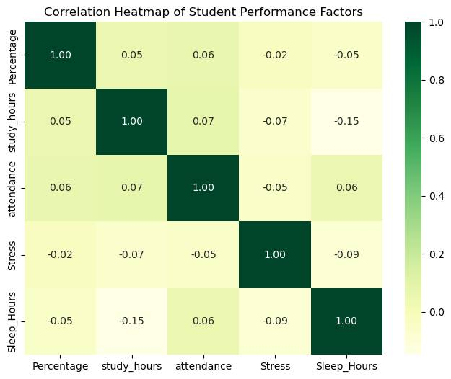
Correlation Analysis
Correlation Analysis of Academic Performance and Study Variables
Interpretations: Academic performance shows very weak correlation with all factors, indicating that no single variable has a strong influence; it is affected by a combination of multiple factors.

Slide 9
Multiple Linear Regression Analysis
Multiple Linear Regression Analysis of Factors Affecting Academic Performance
Interpretation: The regression model was found to be statistically significant, indicating that the selected variables collectively influence academic performance. Among all the variables, internal performance emerged as the most significant predictor, showing a strong positive impact on students' academic achievement. Other factors such as study hours, attendance, stress, sleep, motivation, and family income showed comparatively weaker effects.
Statistic
Value
R²
0.122
Adjusted R²
0.083
F-Statistic
3.115
p-value
0.000369
Observations
283

Slide 10
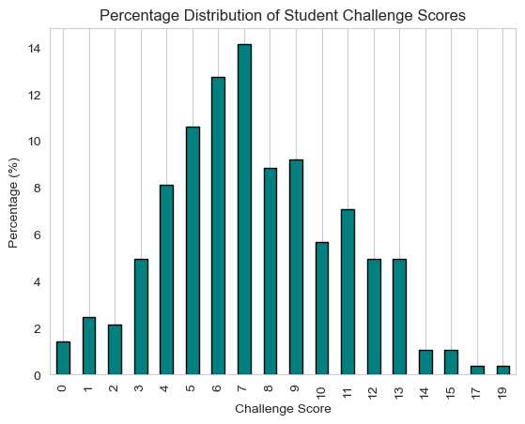
Objective 2 -
To Identify Student Difficulties in Their Studies Using Their Information
Frequency and Percentage Analysis of Student Challenges
Interpretations:
Frequency and percentage distribution of challenge scores were calculated.
The majority of students fall in the moderate challenge score range.
A smaller number of students experience low levels of challenges.
Very few students face high levels of challenges.
Overall, it indicates that most students experience a moderate level of academic and personal challenges.

Slide 11
Comparative Analysis
Overall, students face a moderate level of challenges, with a mean challenge score of 7.37.
Across Academic Streams
Across Area (Urban vs Rural)
Stream
Mean Challenge Score
Area
Mean Challenge Score
Arts
7.62
Rural
7.72
Commerce
8.09
Urban
6.98
Management
7.71
Science
6.98
Across Income Group
Income Group
Mean Challenge Score
1 (Lowest)
7.19
2
7.51
3
7.73
4 (Highest)
9.00
Key Interpretations
Commerce students exhibit the highest mean challenge score (8.09), indicating they face more academic and personal difficulties compared to other streams.
Students from rural areas experience higher challenges (7.72) than their urban counterparts (6.98).
A notable trend shows that students in higher income groups (e.g., Group 4 with 9.00) report significantly higher challenge scores, suggesting that challenges are not exclusively tied to lower socioeconomic status but can vary across different income brackets.
These findings highlight that student challenges are diverse and vary significantly across different demographic and academic groups, rather than being uniformly distributed.

Slide 12
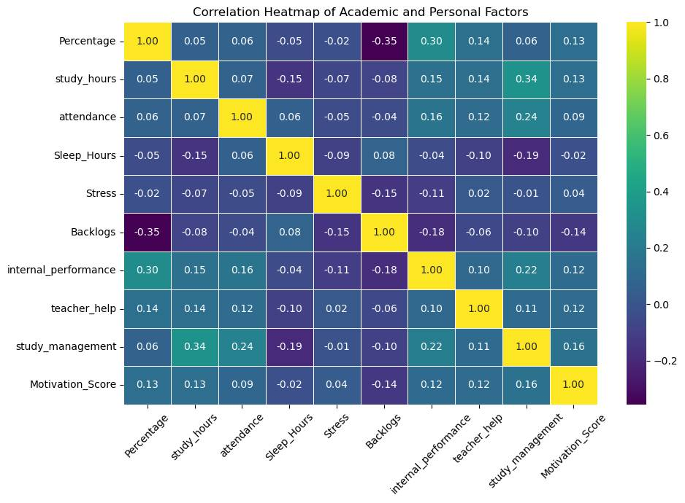
Objective 3 -
To Examine the Relationship Between Students' Personal Experiences,
Study Habits, and Academic Achievement
Correlation Analysis of Factors Affecting Students' Academic Performance
Overall, Internal Performance positively influences academic achievement, while Backlogs adversely affect student performance. Most other variables exhibit only weak correlations.
Internal Performance, Study Management, and Teacher Help show a positive association with academic performance.
Backlogs show the strongest negative association with academic performance.

Slide 13
Chi-Square Test of Independence
Association Between Categorical Variables
Variable Pair
Chi-Square
P-Value
Result
Backlogs vs Internet Access
0.268
0.605
Not Significant
Attendance vs Area
2.932
0.231
Not Significant
Family Income vs Academic Performance
0.241
0.623
Not Significant
Interpretation: All three p-values are greater than 0.05, indicating no statistically significant association between the selected categorical variables. Thus, internet access, area, and family income did not show a significant relationship with student academic outcomes in this study.

Slide 14
Comparison of Academic Performance
t-Test and One-Way ANOVA
Test
Statistic
P-Value
Result
Independent Sample t-Test (Urban vs Rural)
0.904
0.367
Not Significant
One-Way ANOVA (Across Streams)
1.416
0.238
Not Significant
Interpretation: The results indicate no significant difference in academic performance between urban and rural students, as well as across different academic streams. This suggests that area of residence and stream of study do not significantly affect students' academic performance.

Slide 15
Objective 4-
To Identify At-Risk Students, Analyse Their Challenges, and Study Their Support Needs
Performance Comparison of Classification Models
Model
Accuracy
Precision
Recall
F1-Score
Logistic Regression
89.47%
0.83
0.50
0.62
Random Forest
87.72%
0.80
0.40
0.53
XGBoost
85.96%
0.67
0.40
0.50
Interpretation:
Logistic Regression shows the best overall performance with the highest accuracy (89.47%).
Random Forest also performs well with good accuracy (87.72%) and strong precision.
XGBoost gives slightly lower accuracy (85.96%) but has competitive precision and recall.
All models show moderate ability in identifying at-risk students.
Overall, Logistic Regression is identified as the best model for this classification task, while Random Forest and XGBoost also provide reliable results for identifying at-risk students.

Slide 16

Exploratory Factor Analysis (EFA)
Identification of Major Student Challenge Dimensions
Sampling Adequacy
Test
Value
KMO (Kaiser-Meyer-Olkin)
0.555
Bartlett's Test
p < 0.001
Academic Support and Group Study
Digital Learning
Personal and Health Issues
Difficulties associated with online resources, virtual platforms, and technology integration in studies.
Factors encompassing mental well-being, physical health, and personal life stressors impacting academic focus.
Challenges related to seeking help, understanding course material, and collaborating with peers.
Distractions (Mainly Mobile Usage)
Self-Study
Challenges in independent learning, time management, and developing effective study routines without direct supervision.
Impact of external interruptions, particularly from mobile devices, on concentration and study habits.
Interpretation: The KMO value indicates moderate sampling adequacy, and Bartlett's test is highly significant, confirming that the data is suitable for factor analysis. The analysis identified five major dimensions of student challenges, namely academic support, digital learning, personal issues, distractions, and self-study. These factors represent distinct areas where students face difficulties, guiding targeted intervention strategies.

Slide 17
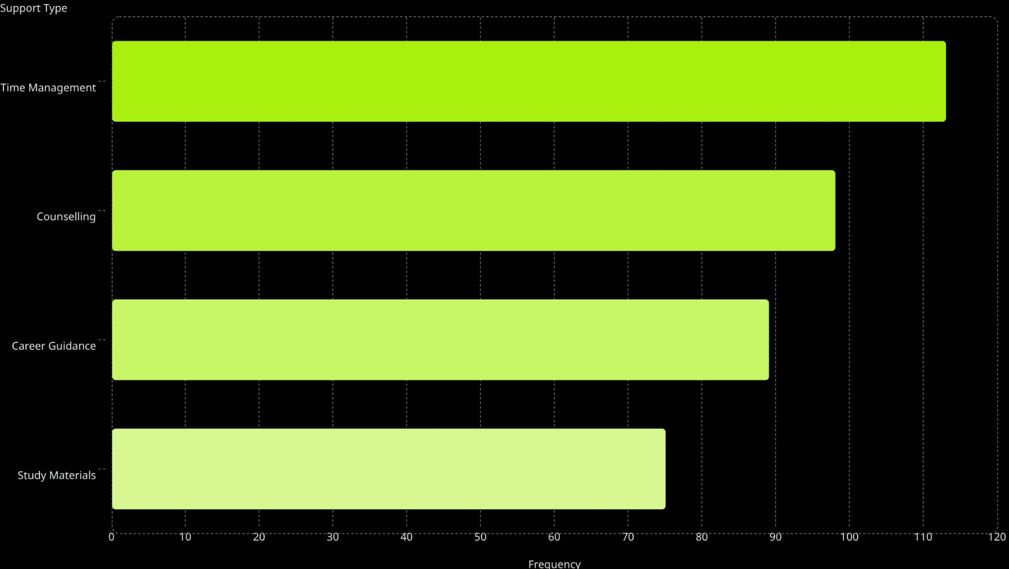

Support Needs Analysis
Support Needs of Students
113
98
89
75
Significant Association with Challenge Level: Only Interactive Learning showed a statistically significant association with student challenge levels (p = 0.016).
The analysis reveals that time management, counselling, and career guidance are the most frequently requested support services by students. While most support types did not show a direct statistical link to the overall challenge level students faced, interactive learning was uniquely identified as a crucial support, significantly impacting students with higher levels of challenges. This suggests that engaging and dynamic learning environments are vital for those struggling most.

Slide 18
Major Findings
This study reveals critical insights into student academic performance, the challenges they face, and their support needs, offering a comprehensive view for targeted interventions.
Performance & Influencing Factors
Challenges Faced by Students
Students exhibit moderate to good academic performance.
Internal performance, study habits, attendance, and teacher help are positive influencers.
Backlogs and stress negatively impact academic outcomes.
Family income does not significantly affect performance.
Students face moderate challenge levels, particularly in Commerce and rural areas.
Key challenge dimensions include academic support, digital learning, personal issues, distractions, and self-study.
Support Needs & Interventions
Time management and counselling are the most frequently needed support services.
Interactive learning is crucial for high-challenge students.
Machine learning models, especially Logistic Regression, effectively identify at-risk students for early intervention.

Slide 19

Recommendations
Based on our findings, we propose the following actionable recommendations to enhance student academic achievement and well-being:
Regularly monitor internal performance and provide targeted support to at-risk students through remedial classes and counseling.
Conduct comprehensive workshops focused on time management, effective study skills, and motivation to foster strong academic habits.
Strengthen and expand counseling services to adequately support students in managing stress and personal challenges.
Implement interactive and student-centered teaching methods to promote deeper engagement and improve learning outcomes.
Encourage consistent teacher-student interaction and provide continuous academic guidance to foster a supportive learning environment.
Offer special support programs tailored for rural and socio-economically weaker students who face additional challenges.
Promote robust career guidance, peer learning initiatives, and collaborative group study opportunities to boost engagement.
Utilize machine learning models for the early and proactive identification of at-risk students, enabling timely interventions.

Slide 20

Limitations of the Study
The study is limited to selected undergraduate colleges in Kolhapur District, which may affect the generalizability of the findings.
Being a cross-sectional study, it identifies associations but cannot establish causation between the identified challenges and academic outcomes.
The analysis is based on self-reported student responses, which may involve inherent response bias or inaccuracies.
Some potentially important factors, such as individual personality traits, specific institutional policies, or socio-economic background beyond family income, were not included in the scope of this research.
The statistical models explain only a portion of academic performance variance, indicating that many other unmeasured factors may also significantly influence student achievement.

Slide 21

References
Ramaswami, M., & Bhaskaran, R. (2009). A study on feature selection techniques in educational data mining. arXiv preprint arXiv:0912.3924.
Yadav, S. K., Bharadwaj, B., & Pal, S. (2012). Data mining applications: A comparative study for predicting student's performance. arXiv preprint arXiv:1202.4815.
vamanan, ramesh & Parkavi, P & Ramar, K.. (2013). Predicting Student Performance: A Statistical and Data Mining Approach. International journal of computer applications. 63. 975-8887. 10.5120/10489-5242.
Adhatrao, K., Gaykar, A., Dhawan, A., Jha, R., & Honrao, V. (2013). Predicting students' performance using ID3 and C4. 5 classification algorithms. arXiv preprint arXiv:1310.2071.
Sujatha, G. & S, Sindhu & Savaridassan, P. (2018). Predicting students performance using personalized analytics. International Journal of Pure and Applied Mathematics. 119. 229-237.
Li, Y., Gou, J., & Fan, Z. (2019). Educational data mining for students' performance based on fuzzy C-means clustering. The Journal of Engineering, 2019(11), 8245–8250.
Zhang, Yupei et al. “Educational Data Mining Techniques for Student Performance Prediction: Method Review and Comparison Analysis.” Frontiers in psychology vol. 12 698490. 7 Dec. 2021, doi:10.3389/fpsyg.2021.698490
Lynn, N. D., & Emanuel, A. W. R. (2021). Using Data Mining Techniques to Predict Students’ Performance: A Review. IOP Conference Series: Materials Science and Engineering, 1096, 012083.
Ahmad, B., Zafar, N., & Anwar, H. (2021). Predicting Student’s Performance Using Machine Learning: A Systematic Review. Education Sciences, 11(9), 552.
Syed Mustapha, SMFD. (2023). Predictive Analysis of Students’ Learning Performance Using Data Mining Techniques: A Comparative Study of Feature Selection Methods. Applied System Innovation. 6. 86. 10.3390/asi6050086.
Hussain, M. M., Akbar, S., Ale Hassan, S., Waqas Aziz, M., & Urooj, F. (2024). Prediction of Student’s Academic Performance through Data Mining Approach. Journal of Informatics and Web Engineering, 3(1), 241–251. https://doi.org/10.33093/jiwe.2024.3.1.16

Slide 22

Thank You!
For your attention and interest in our study on student challenges and academic achievement.

